Slide 1

Airlines dataset
By Soham Satpute
Credits: Kaggle

Slide 2

How to Start Being a Digital Nomad
Reduce and Eliminate Expenses
Decide on a Location
Set Goals and Create a Plan

Slide 3

The mean age of flight attendees is 45.3 even though the life expectancy average is only about 72 years
= 45.3

Slide 4
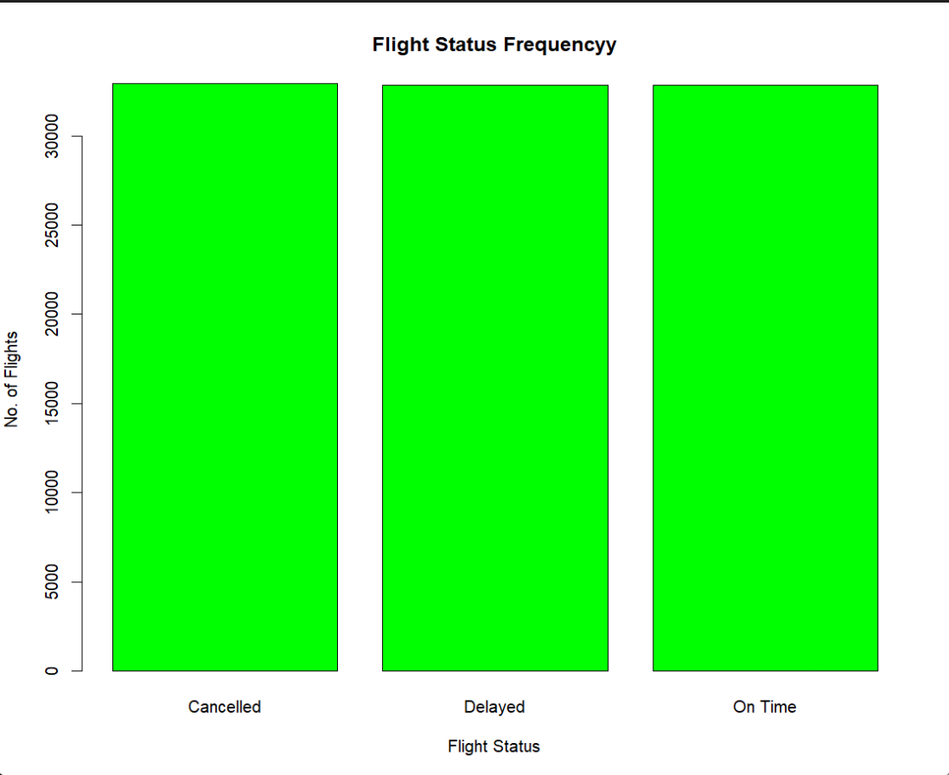
The flight status is evenly distributed instead of mostly being on-time

Slide 5
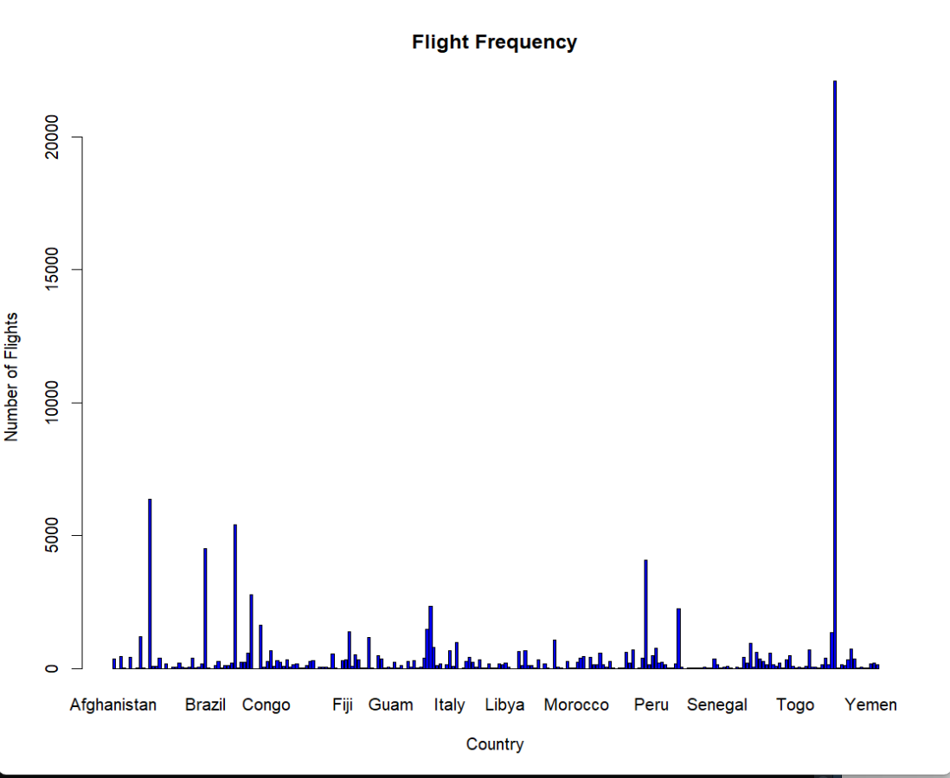
United States has the most Flight Frequency of 22104 though being quite less populated

Slide 6
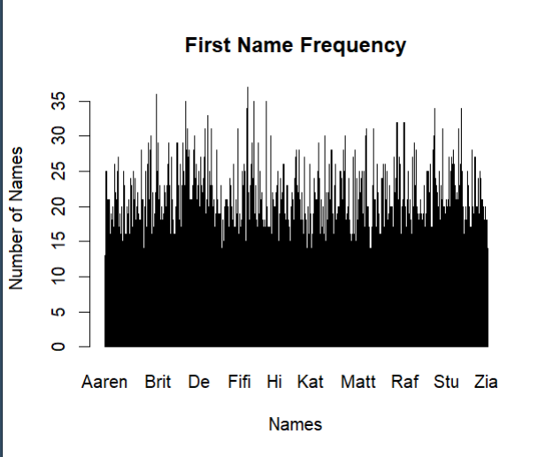
People whose names begin with Aa contain about 5% of the total population (Statistically should be 0.14793%)

Slide 7
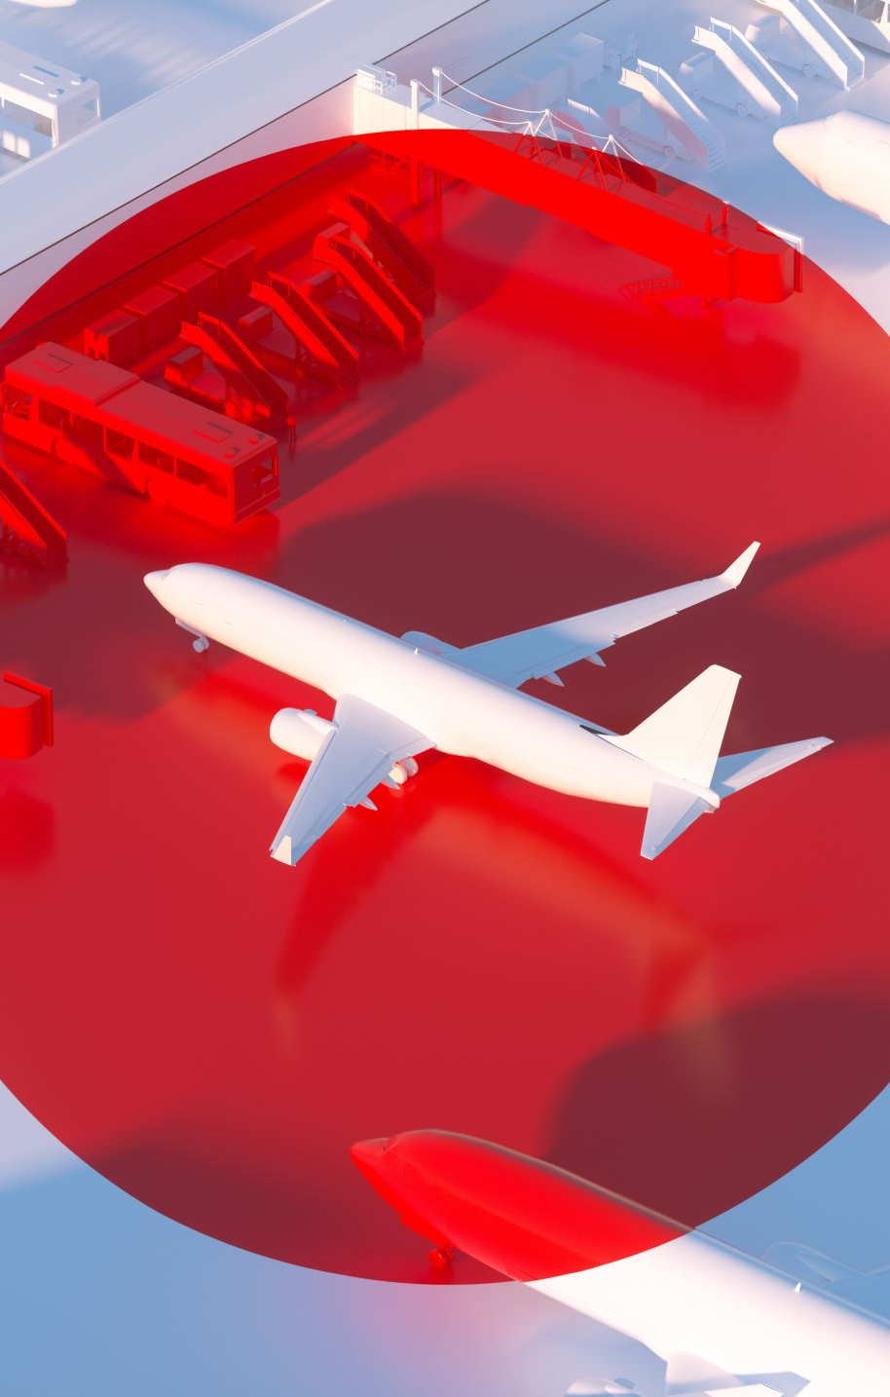
The maximum age of a person who uses air travel is 102 which is quite unexpected
Max(Age) = 102 Years!

Slide 8
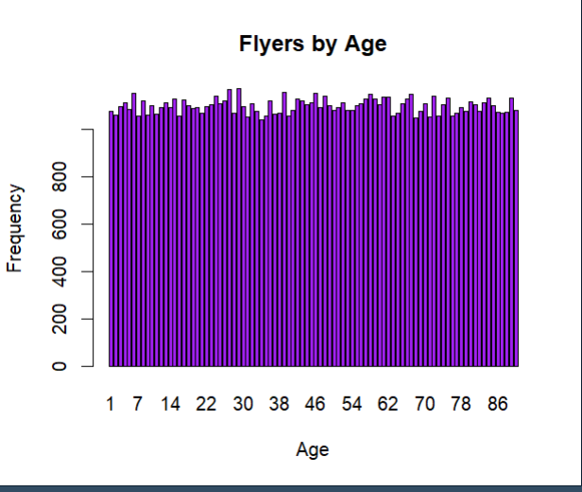
It is surprising to see that the frequency of flight takers are evenly distributed instead of normally distributed

Slide 9
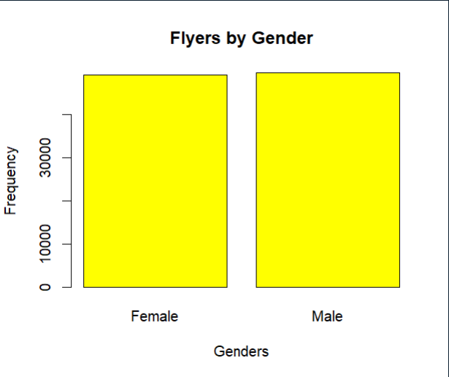
Its quite unexpected to see only male and female genders in flyers, with this evolving world I hoped the dataset contained of other genders (created in 2022). Not a good finding but will make work as a point. I expected more than 2 genders

Slide 10
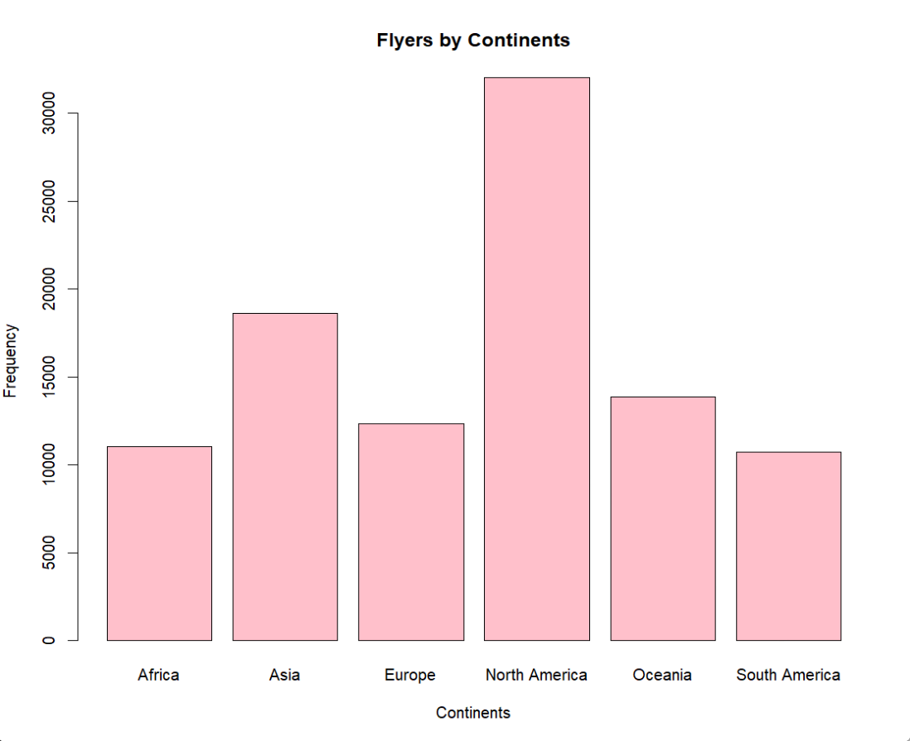
North America has the greatest number of airplanes whereas South America has the least - kind of ironic

Slide 11
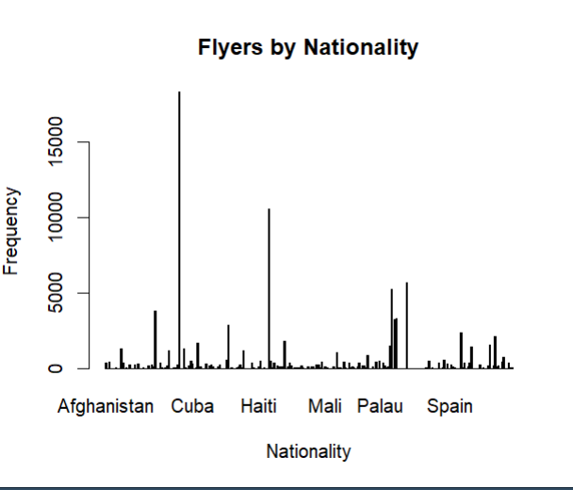
China has a WHOOPING 18317 Citizens flying planes even though most flights are from USA

Slide 12

Thank you
~ by Soham Satpute

